Slide 1
Birth Certificate Database
BRIT SYSTEMS User Guide
Debbie Brendemihl
PPE
May 13, 2017

Slide 2
Welcome
The BRIT System Birth Certificate Database Project is a collaboration between the HIT (Health Information Technology) students, Kaytie and Debbie and the BIT (Business Information Technology) students Anthony, Michael, Jen and Will. This system is designed to be a “playground” site for HIT students to gain hands on experience with data entry into the birth registry form.
The acronym BRIT was designed by the BIT students and means Birth Registry Information Technology.
The design of the system is based on the US Standard Certificate of Live Birth.

Slide 3
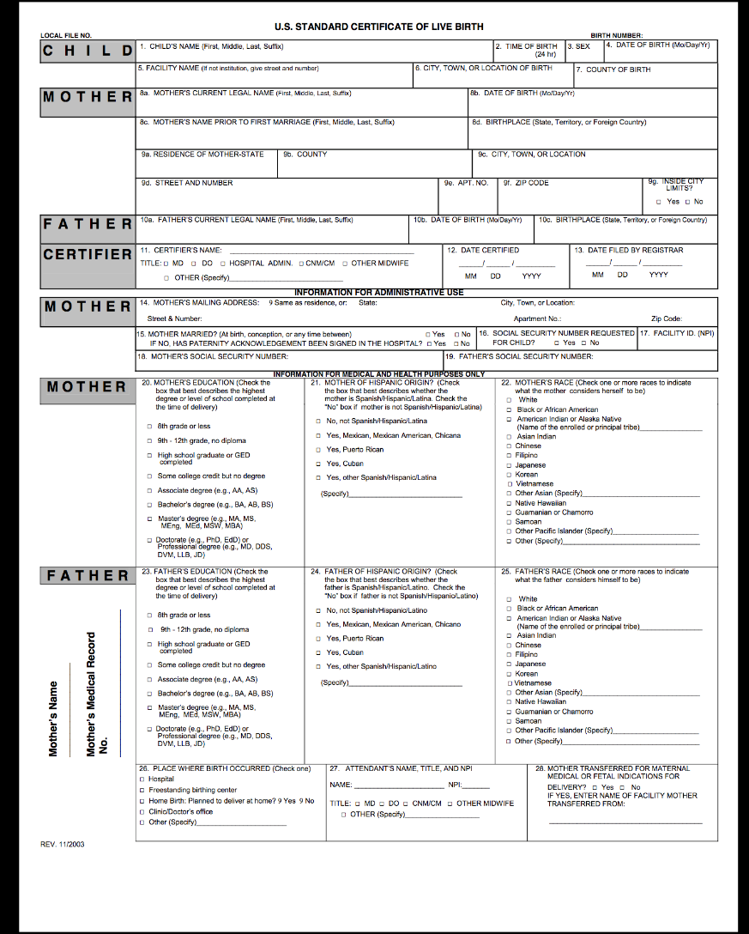
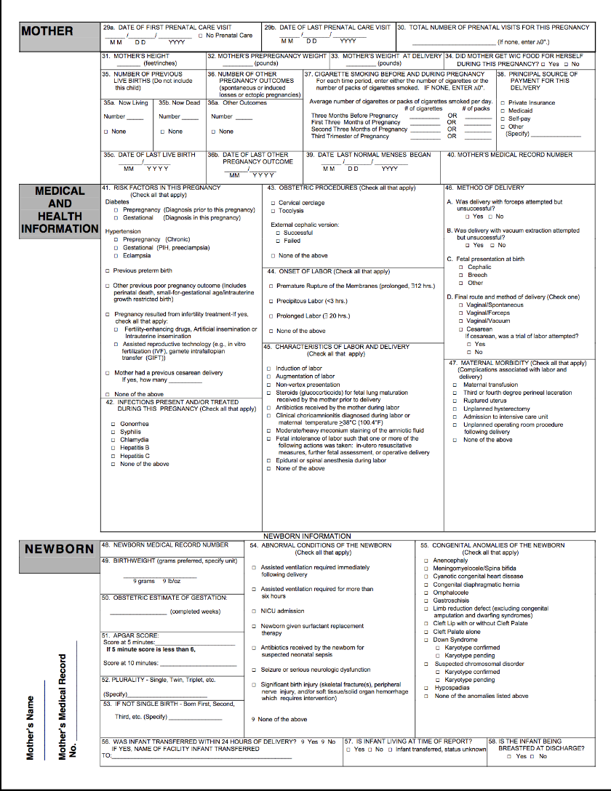
US Standard Certificate of Live Birth
Notes:
Source:https://www.cdc.gov/nchs/data/dvs/birth11-03final-acc.pdf

Slide 4
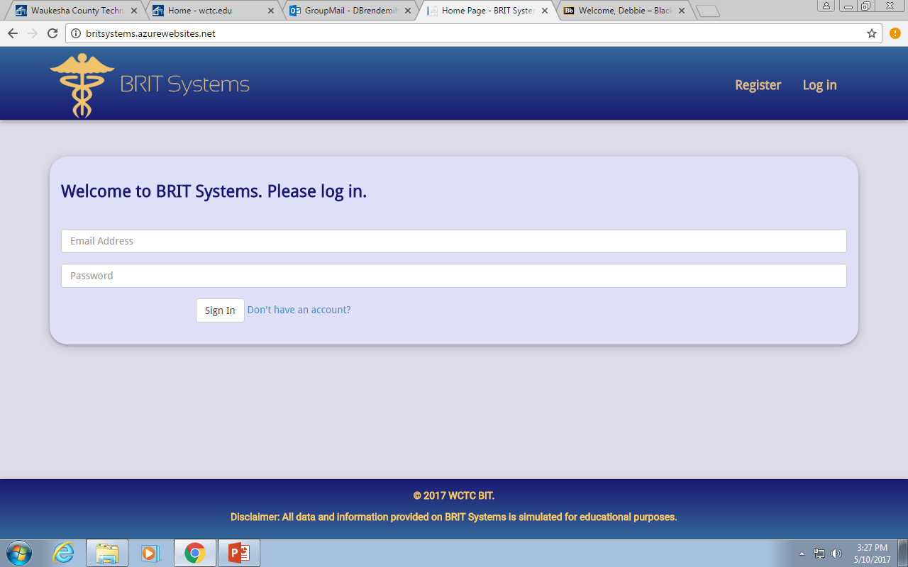
Getting Started
The first screen that you will encounter is the log in screen, this screen will allow the user to log in if they already have an account (must be a WCTC student email account) or they will have the option to create an account.

Slide 5
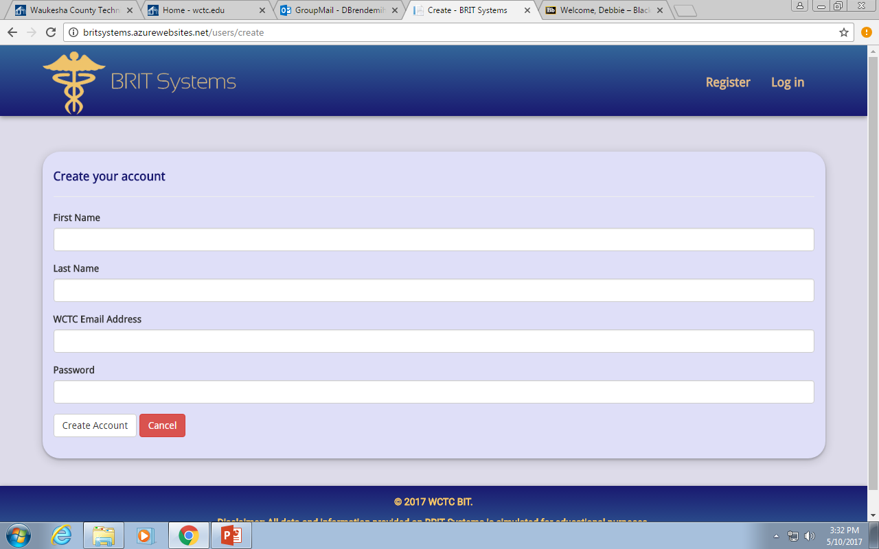
To Create an Account
To Create an account you will need to enter:
First Name
Last Name
WCTC email account
Password: the password must consist of 10 digits (one upper case, one lower case and at least
one number.

Slide 6
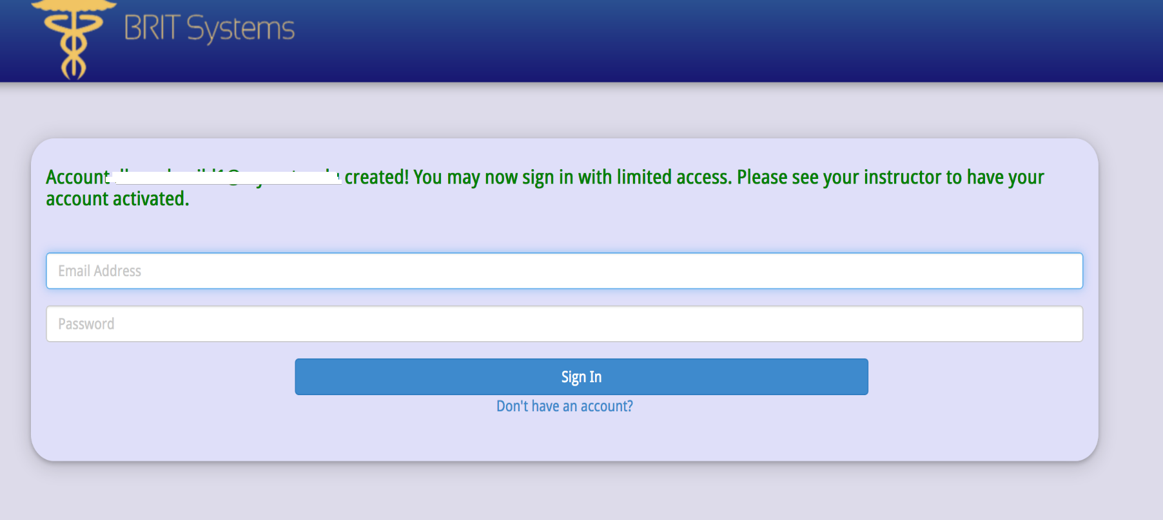
Limited Access
Only individuals who have been activated will have full access to the system. If you receive
the message below, you have not been granted access by the instructor. Please see instructor if
you believe that you should have active status.

Slide 7
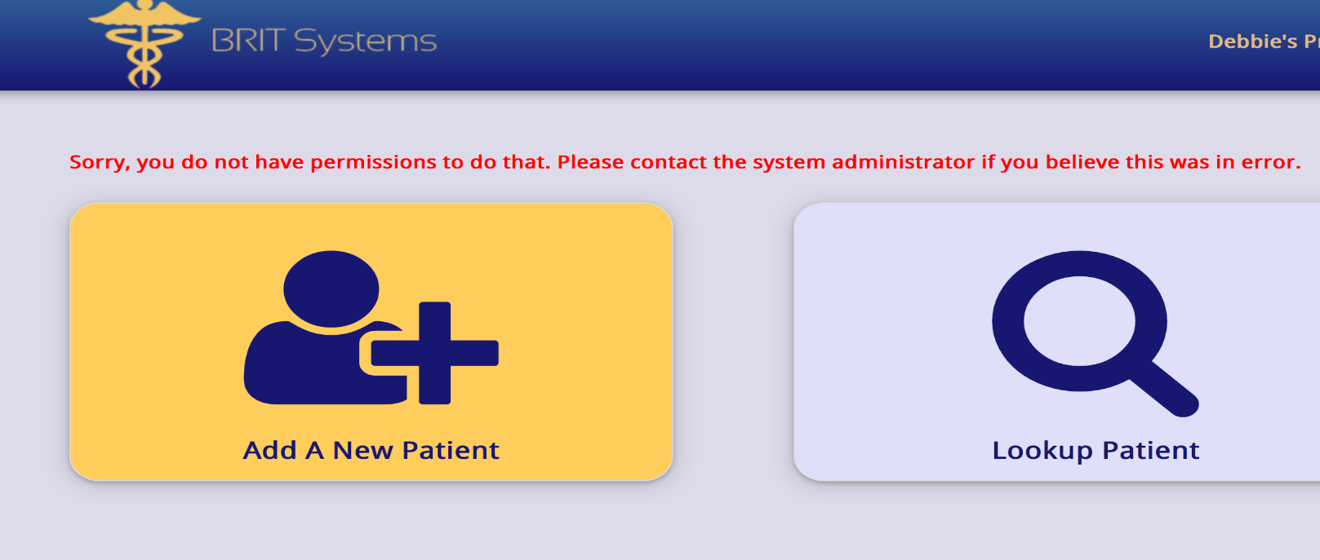
Patient Entry
Once you have successfully entered the system, you will be given a
choice of what you want to do:
Look up an existing patient
Create a new patient
Please note that if you don’t have permission to enter the site, you
will need to contact your instructor and will not be allowed to proceed.

Slide 8
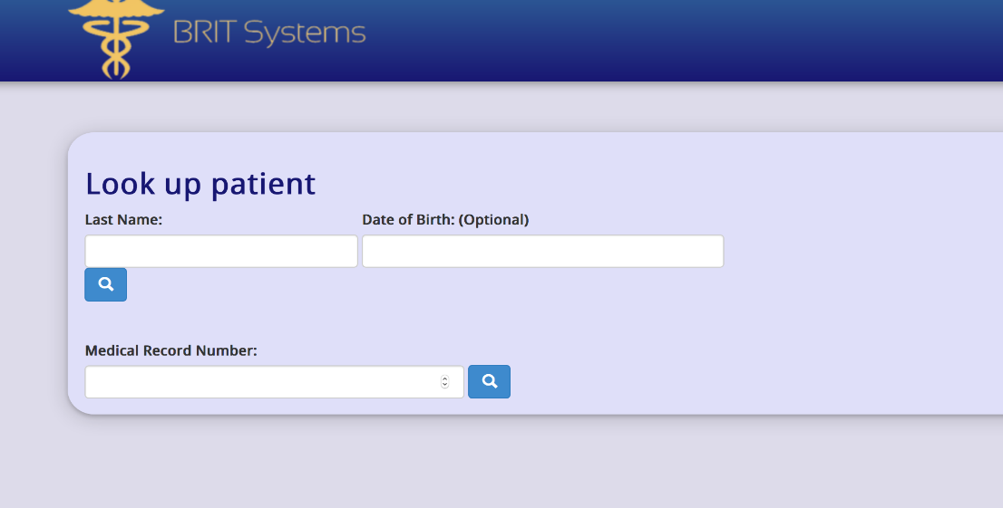
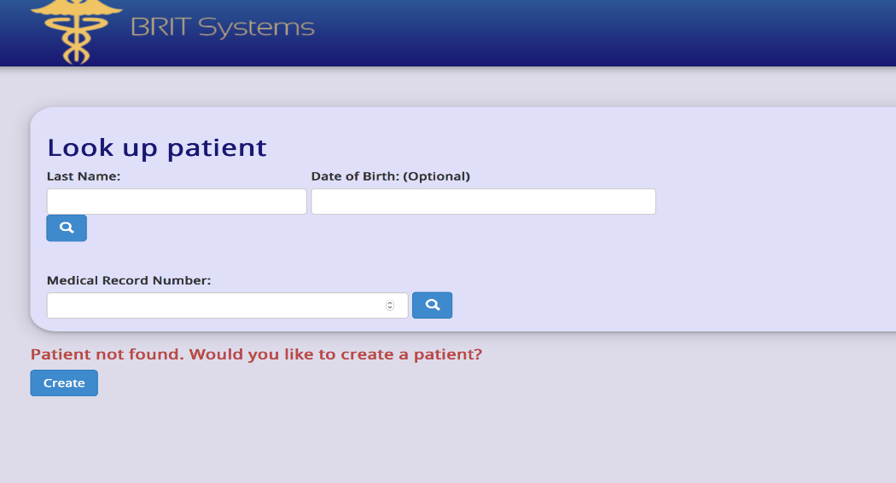
Look Up Patient
You have two choices on how to look up a patient that
may be in the system:
Enter Patient Last Name and (date of birth if known)
Enter Patient Medical Record Number
If the patient is not found in the system, you will be asked if you want to create a patient

Slide 9
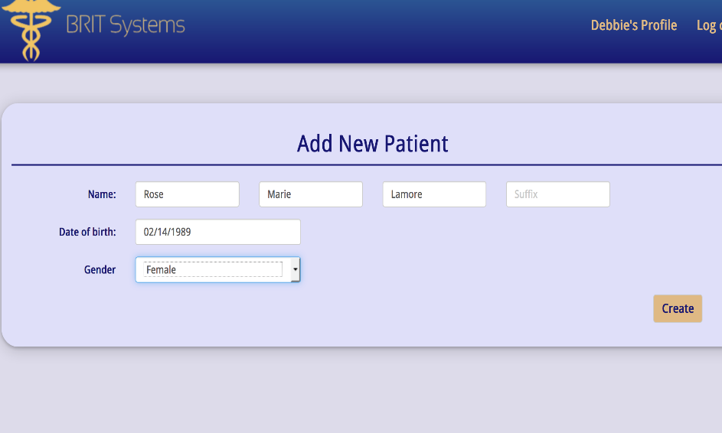
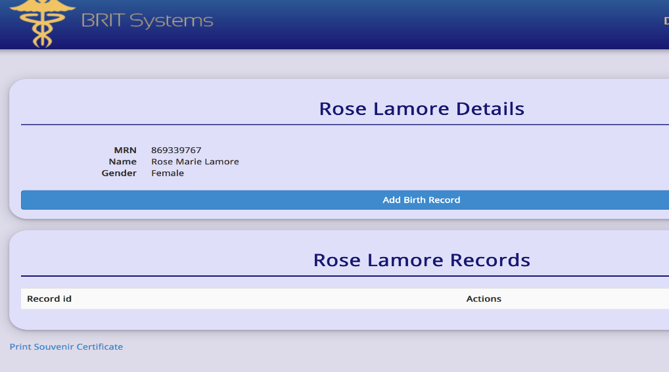
Create Patient
Because this is information for the birth registry, the patient that will be created here is the mother.
Once the patient is created, a detail page will
appear and this is where you can add the birth record.

Slide 10
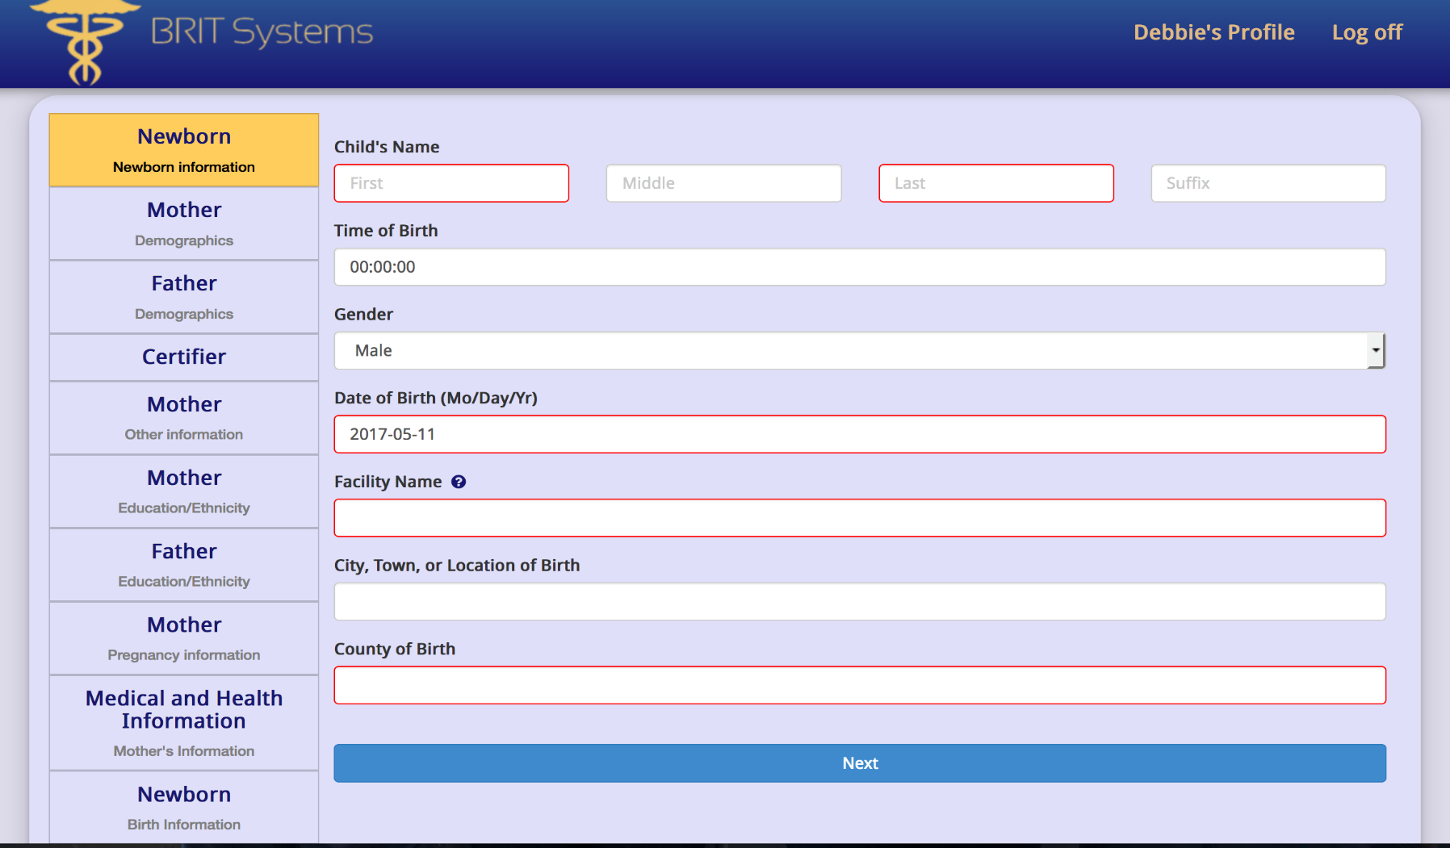
Newborn Record
These boxes
correspond to
the various sections
on the standard form
Information that is supplied within this screen relates to the newborn. Note
that boxes highlighted in RED are required fields.

Slide 11
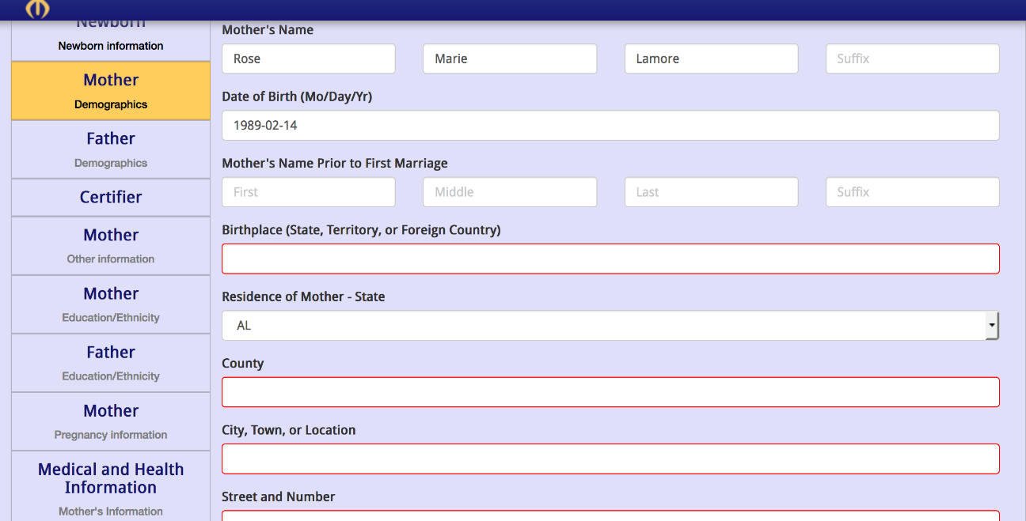
Mother Demographics
Information pertaining to the mother is placed in this screen. Note that the mother that was created as a new patient is populated over to this screen.

Slide 12
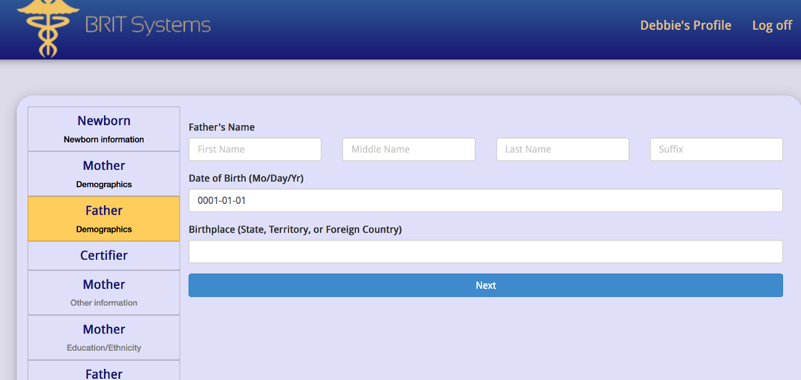
Father Demographics
Information regarding the Father is placed in this field. It should be noted that data that is entered for the father will be saved for future use.

Slide 13
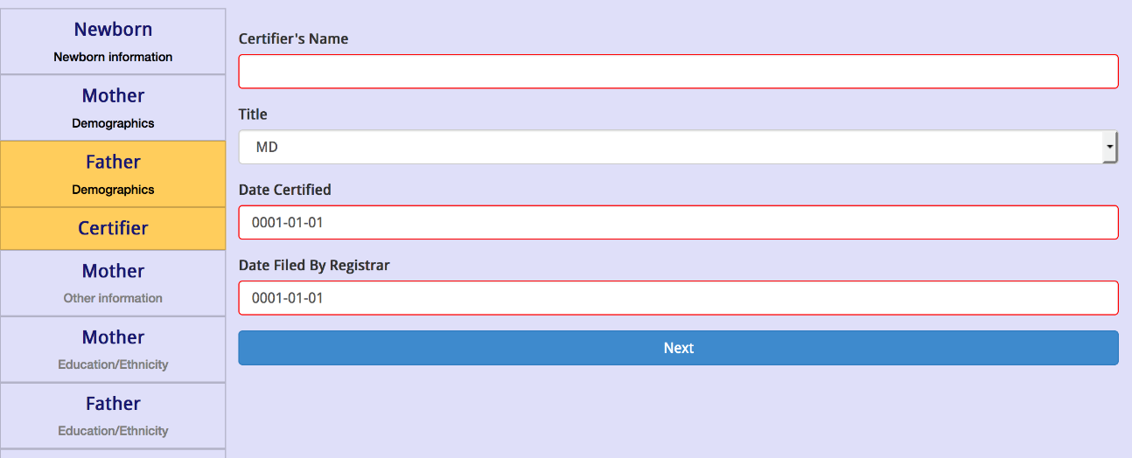
Certifier
The Certifier is the individual who certifies that the birth occurred on the date, time and place that is listed on the record. This individual can be the physician , also known as the attendant, or it can be any other individual that can confirm the birth information.
The date certified is the date that the birth is confirmed, that is generally the day of the birth.
Date filed by the Registrar is the date that the record is filed, in Wisconsin it should be filed within 5 days after the birth. ( Statute 69.14 Registration of births.)
Note the drop down box allows for choice of title of certifier.
Notes:
Source: https://docs.legis.wisconsin.gov/statutes/statutes/69/I/15

Slide 14
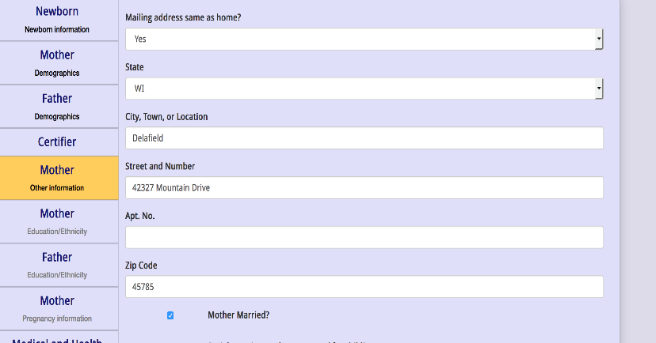
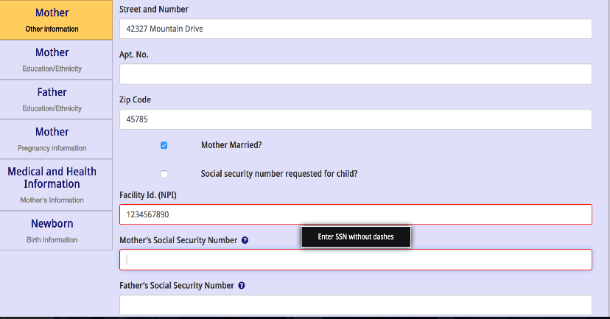
Mother (Other Information)
This field captures additional information regarding the mother, father and the the facility where the birth occurred. If the mailing address is the same as the home address, the information will populate over and auto-fil. There is a spot to check if a Social Security number is requested for the child.
If the mother is not married, a box will appear asking if a Paternity Acknowledgement has been signed.
A Paternity Acknowledgement is a form (voluntary in Wisconsin) that when signed establishes that the male is the legal father of the child and his name is placed on the birth certificate. This is only signed if the mother is NOT married to the male.
The facility ID (NPI) is the unique 10 digit number that identifies a healthcare provider. It is issued by the Centers for Medicare and Medicaid (CMS).
Note that if you hover over the question marks
a “help” message will appear to guide the user on how to
Input the information
Notes:
Source: https://dcf.wisconsin.gov/files/cs/pubs/path-training-handbook.pdf
https://www.cms.gov/Regulations-and-Guidance/Administrative-Simplification/NationalProvIdentStand/

Slide 15
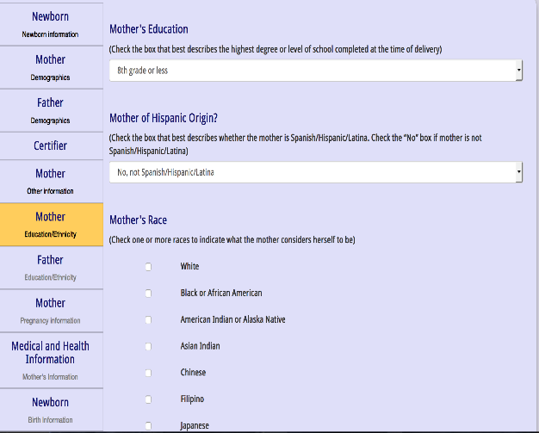
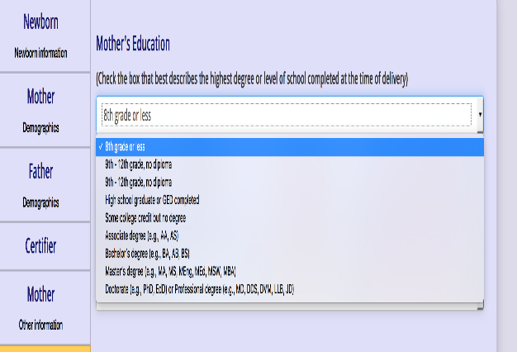
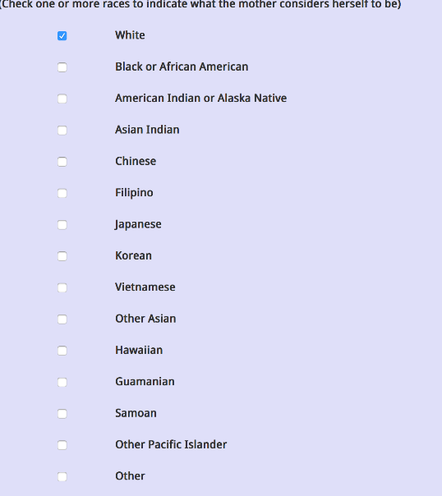
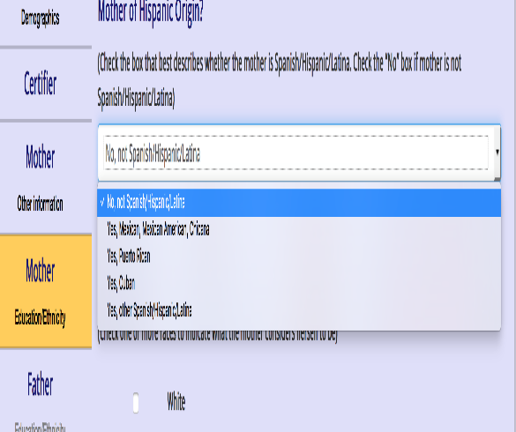
Mother and Father Education and Ethnicity
The fields shown here are the same for both
the Mother and Father regarding education and
ethnicity. Note that drop down boxes are available
for education choice and Hispanic origin. Multiple
choices are available for race with the option to
choose all that apply.

Slide 16
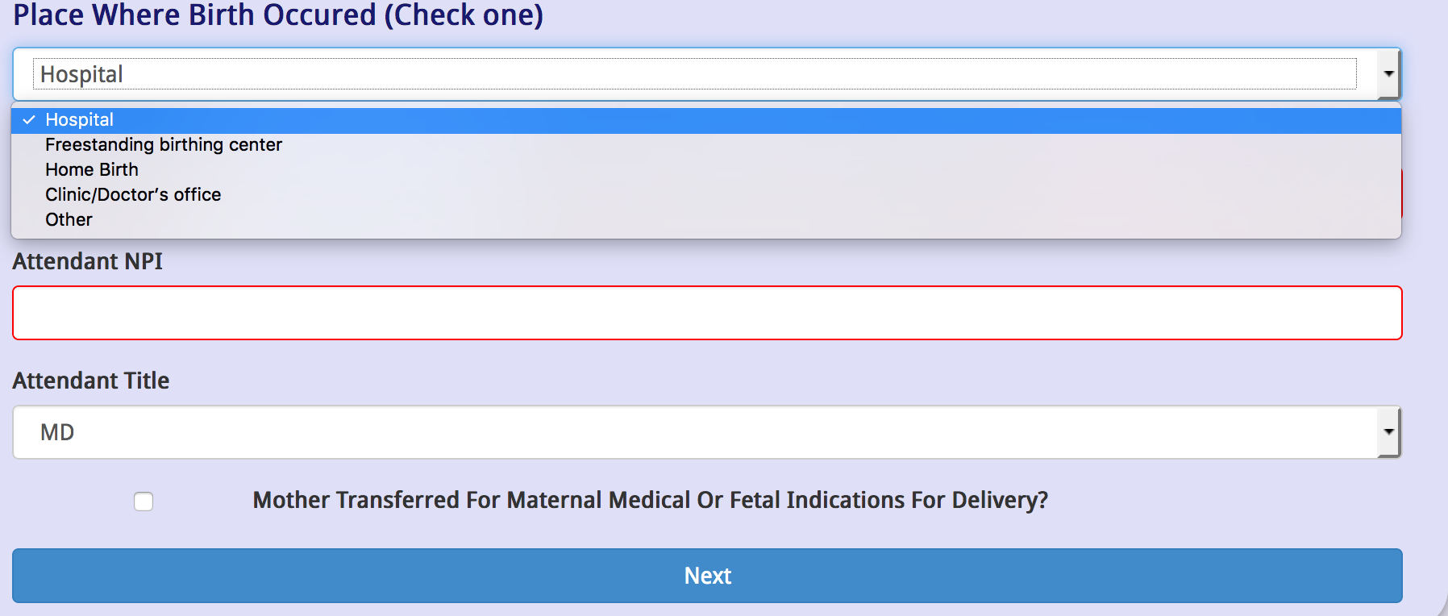
Birth Information
Information regarding what type of facility the child was born at and the name and NPI of the attendant are supplied in this field.
If the box is checked for “Mother
Transferred”, a field will appear that allows for entry of the facility.

Slide 17
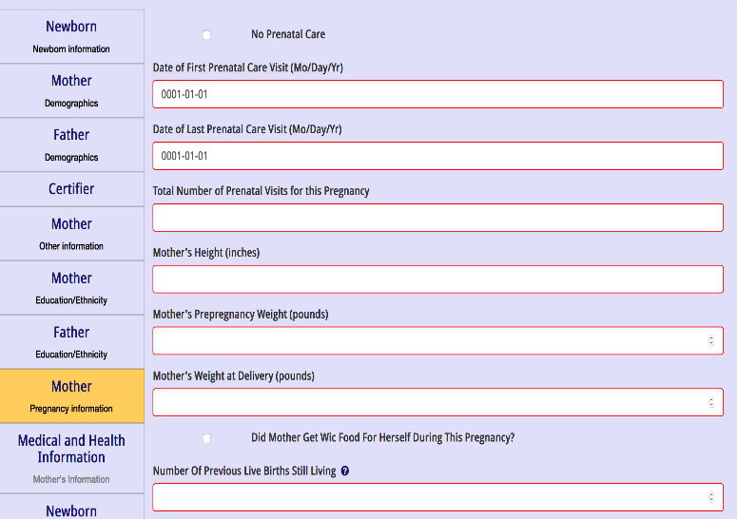
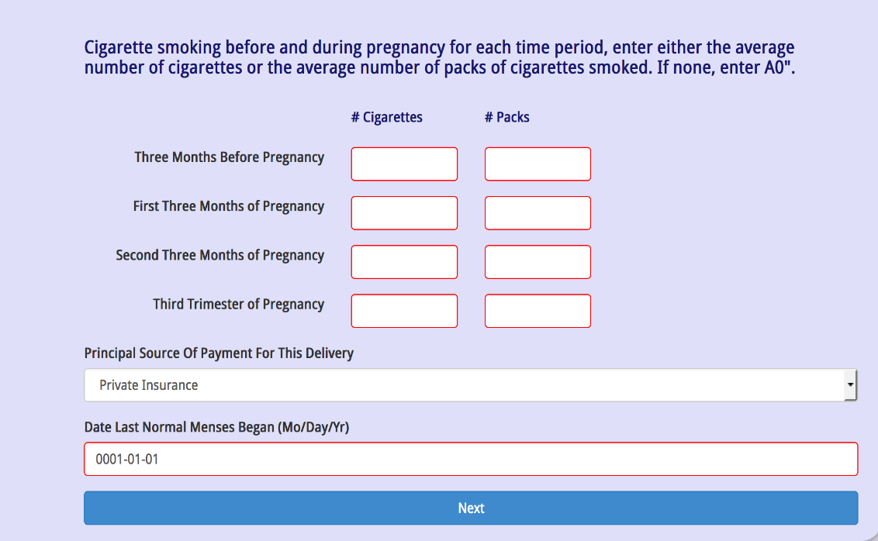
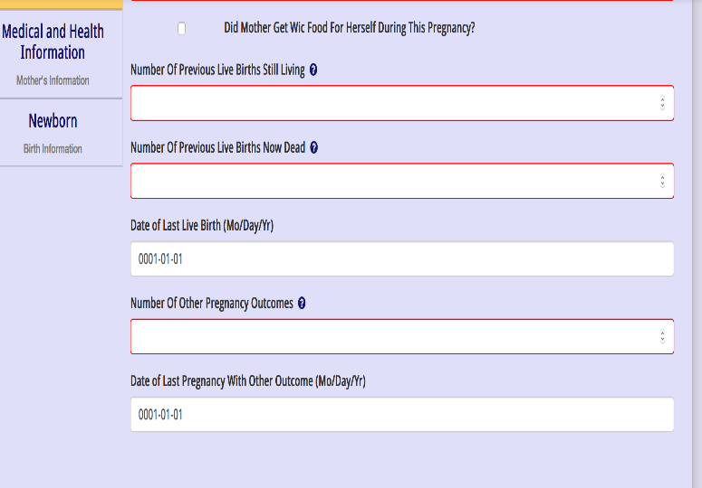
Pregnancy Information
Information regarding smoking is required in this
field. If no smoking is present, enter a “0” in the box
Data relating to the pregnancy is the focus of this
field. It is important to pay attention to the parameters
that are requested (pounds, inches, etc)

Slide 18
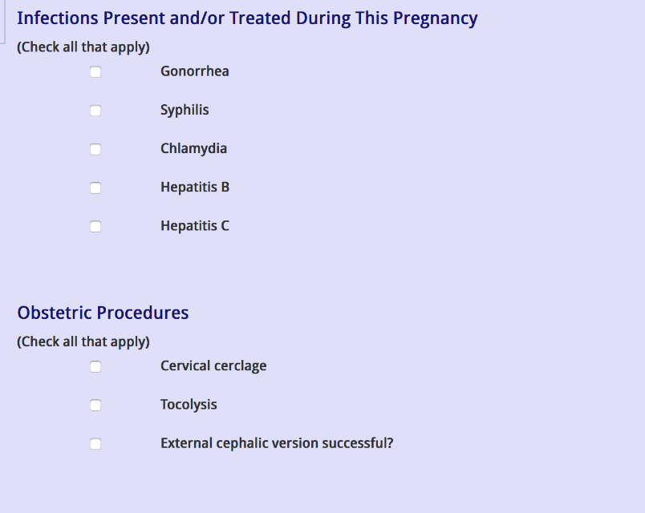
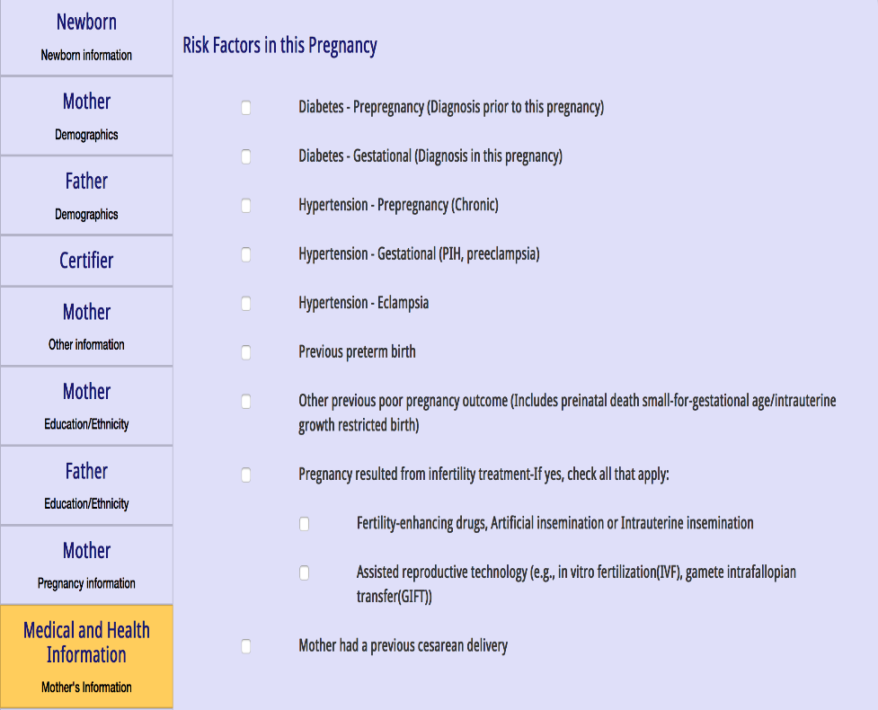
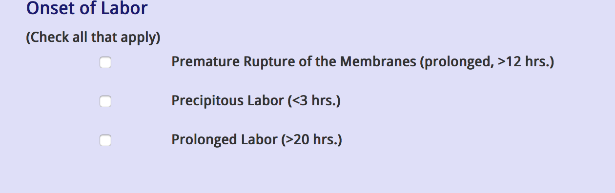
Medical and Health Information
Information gathered in this field
relate to the conditions associated with
the pregnancy or condition of the mother.
Several fields are associated with this portion.

Slide 19
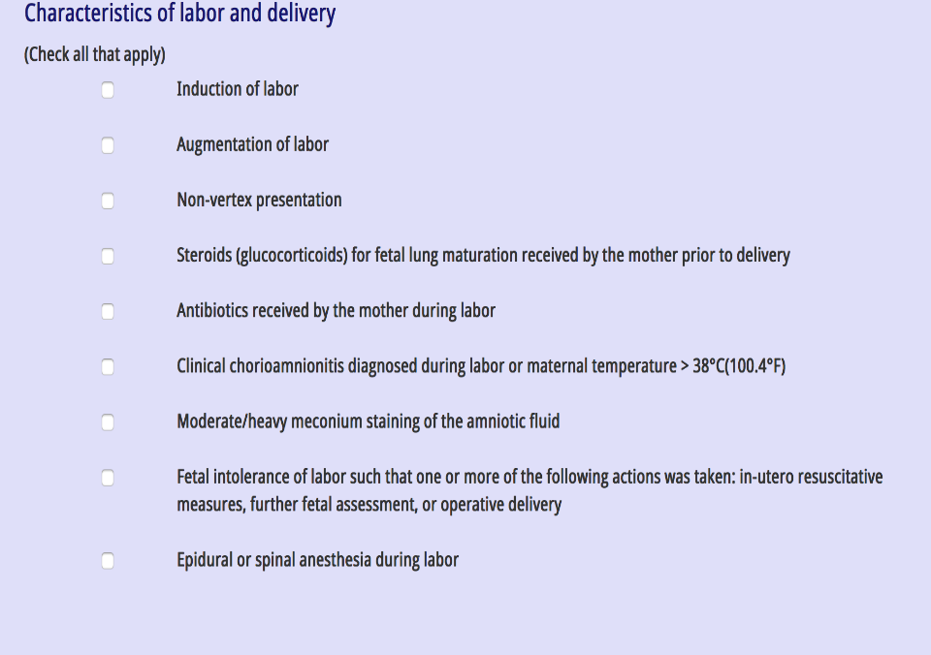
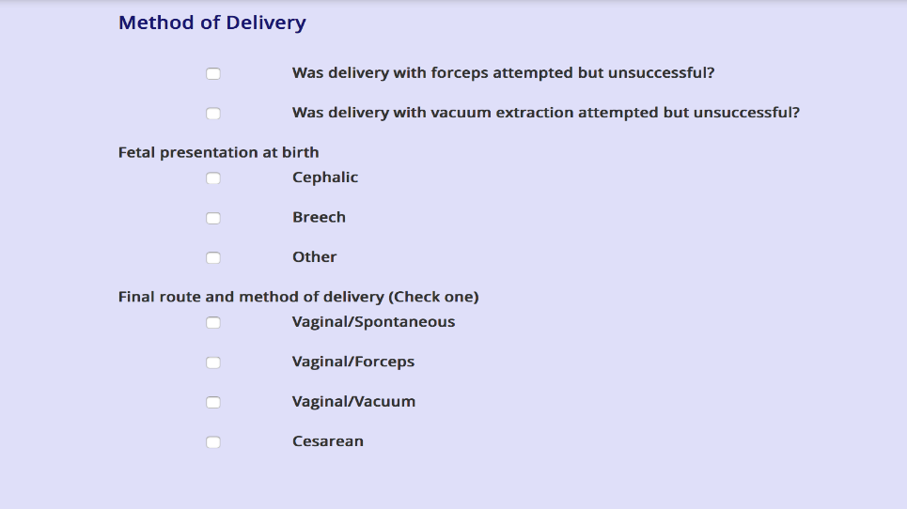
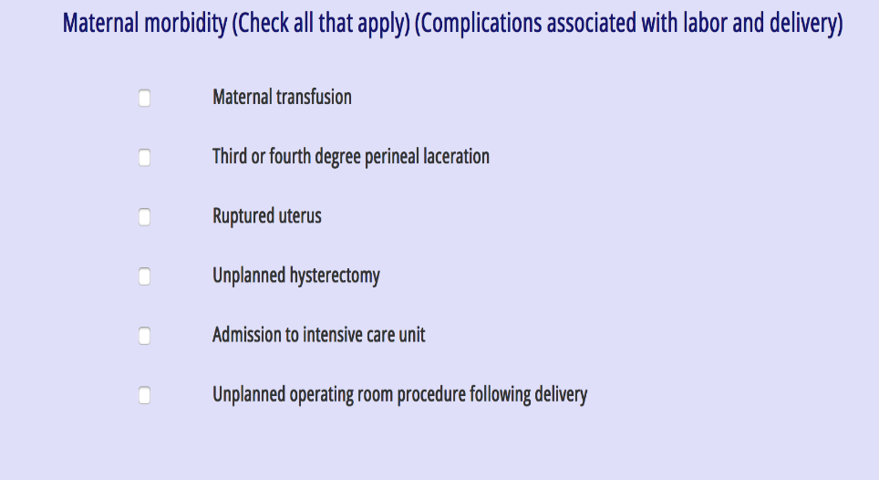
Medical and Health Information
Information that is obtained here
Is related to labor and delivery

Slide 20
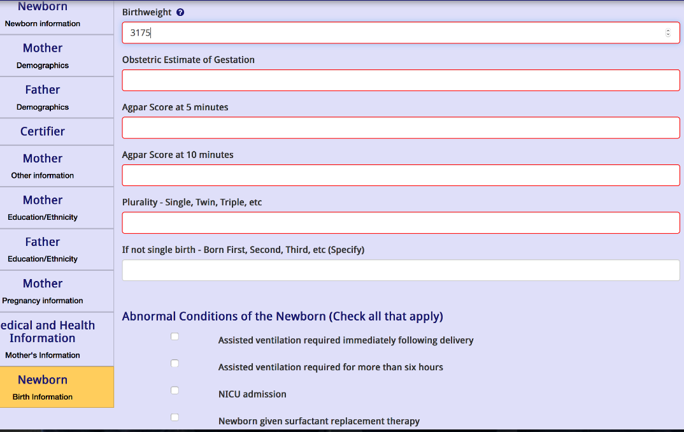
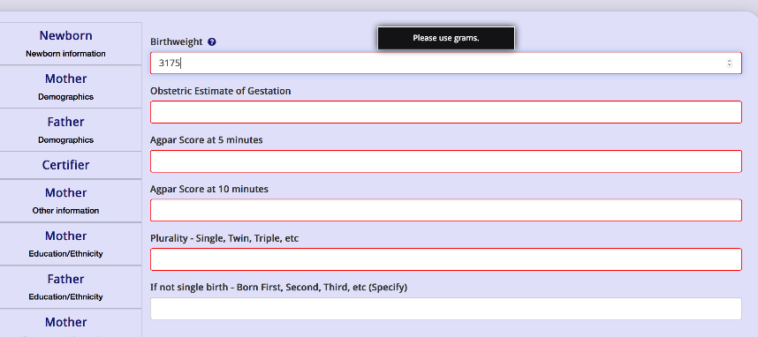
Newborn Birth Information
Information that is entered into the Newborn
birth deals only with the newborn themselves.
Notice that all fields are required to be filled out.
Note that for birthweight is required in grams, a pop up help
box shows up to remind the user of this request.

Slide 21
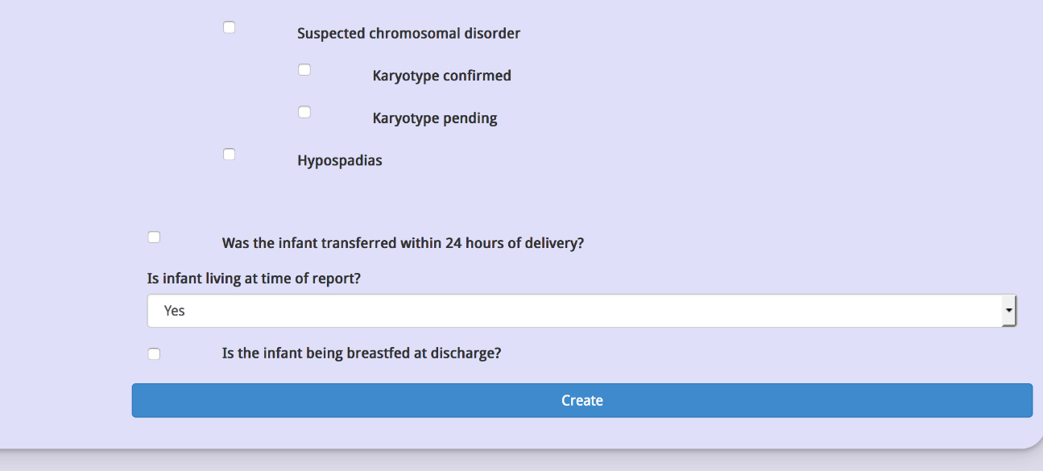
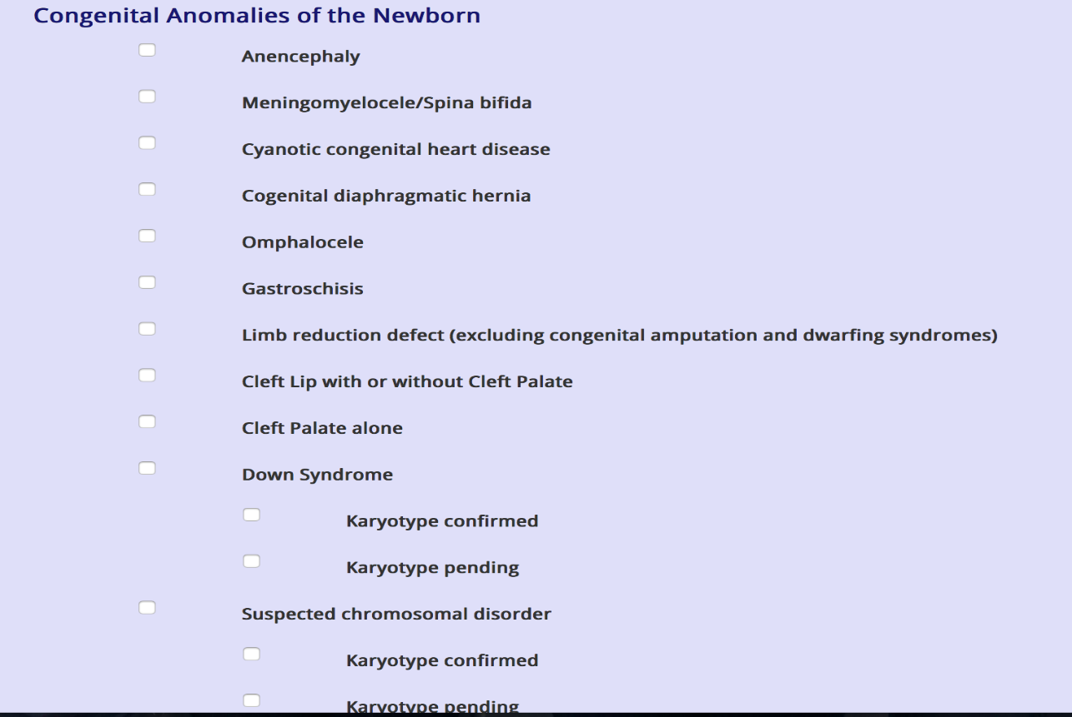
Newborn Birth Information
Once all the information is filled
out regarding the newborn’s birth
you are ready to hit create and
the newborn is now entered into
system.

Slide 22
Questions
This user guide is designed to help navigate through the many fields that are required to fill out the Standard Certificate of Live Birth.
If you have any questions regarding the use of this system or the information contained within the Standard Certificate, please contact your instructor.
Information regarding the Standard Certificate can be found at
https://www.cdc.gov/nchs/data/dvs/GuidetoCompleteFacilityWks.pdf

